Slide 1
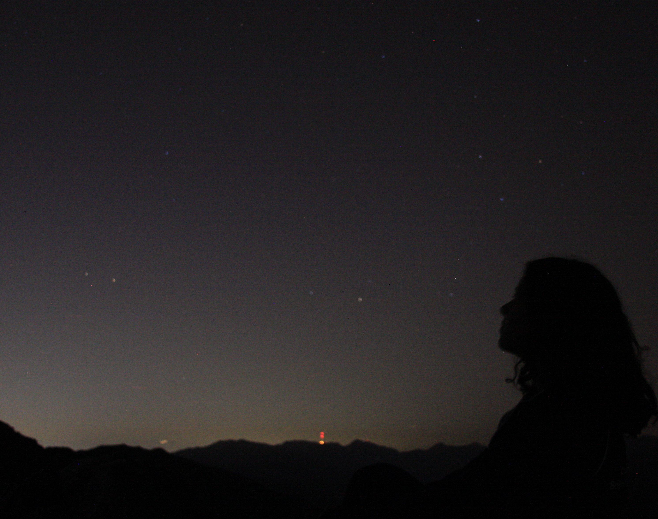
Astronomy 100/1 Lab 6
COVID REMINDERS: We strongly encourage you to keep wearing your mask properly over your nose and mouth while indoors.
Yvonne Ban
Cow Canyon Saddle, Mt. Baldy
Los Angeles, CA
24 Oct 2014
Spring 2022

Slide 2
Fill out the Lab 6 pre-lab survey in Moodle.
Take note of your table today as we will ask you to return to the same table and use the same star for the next lab.

Slide 3
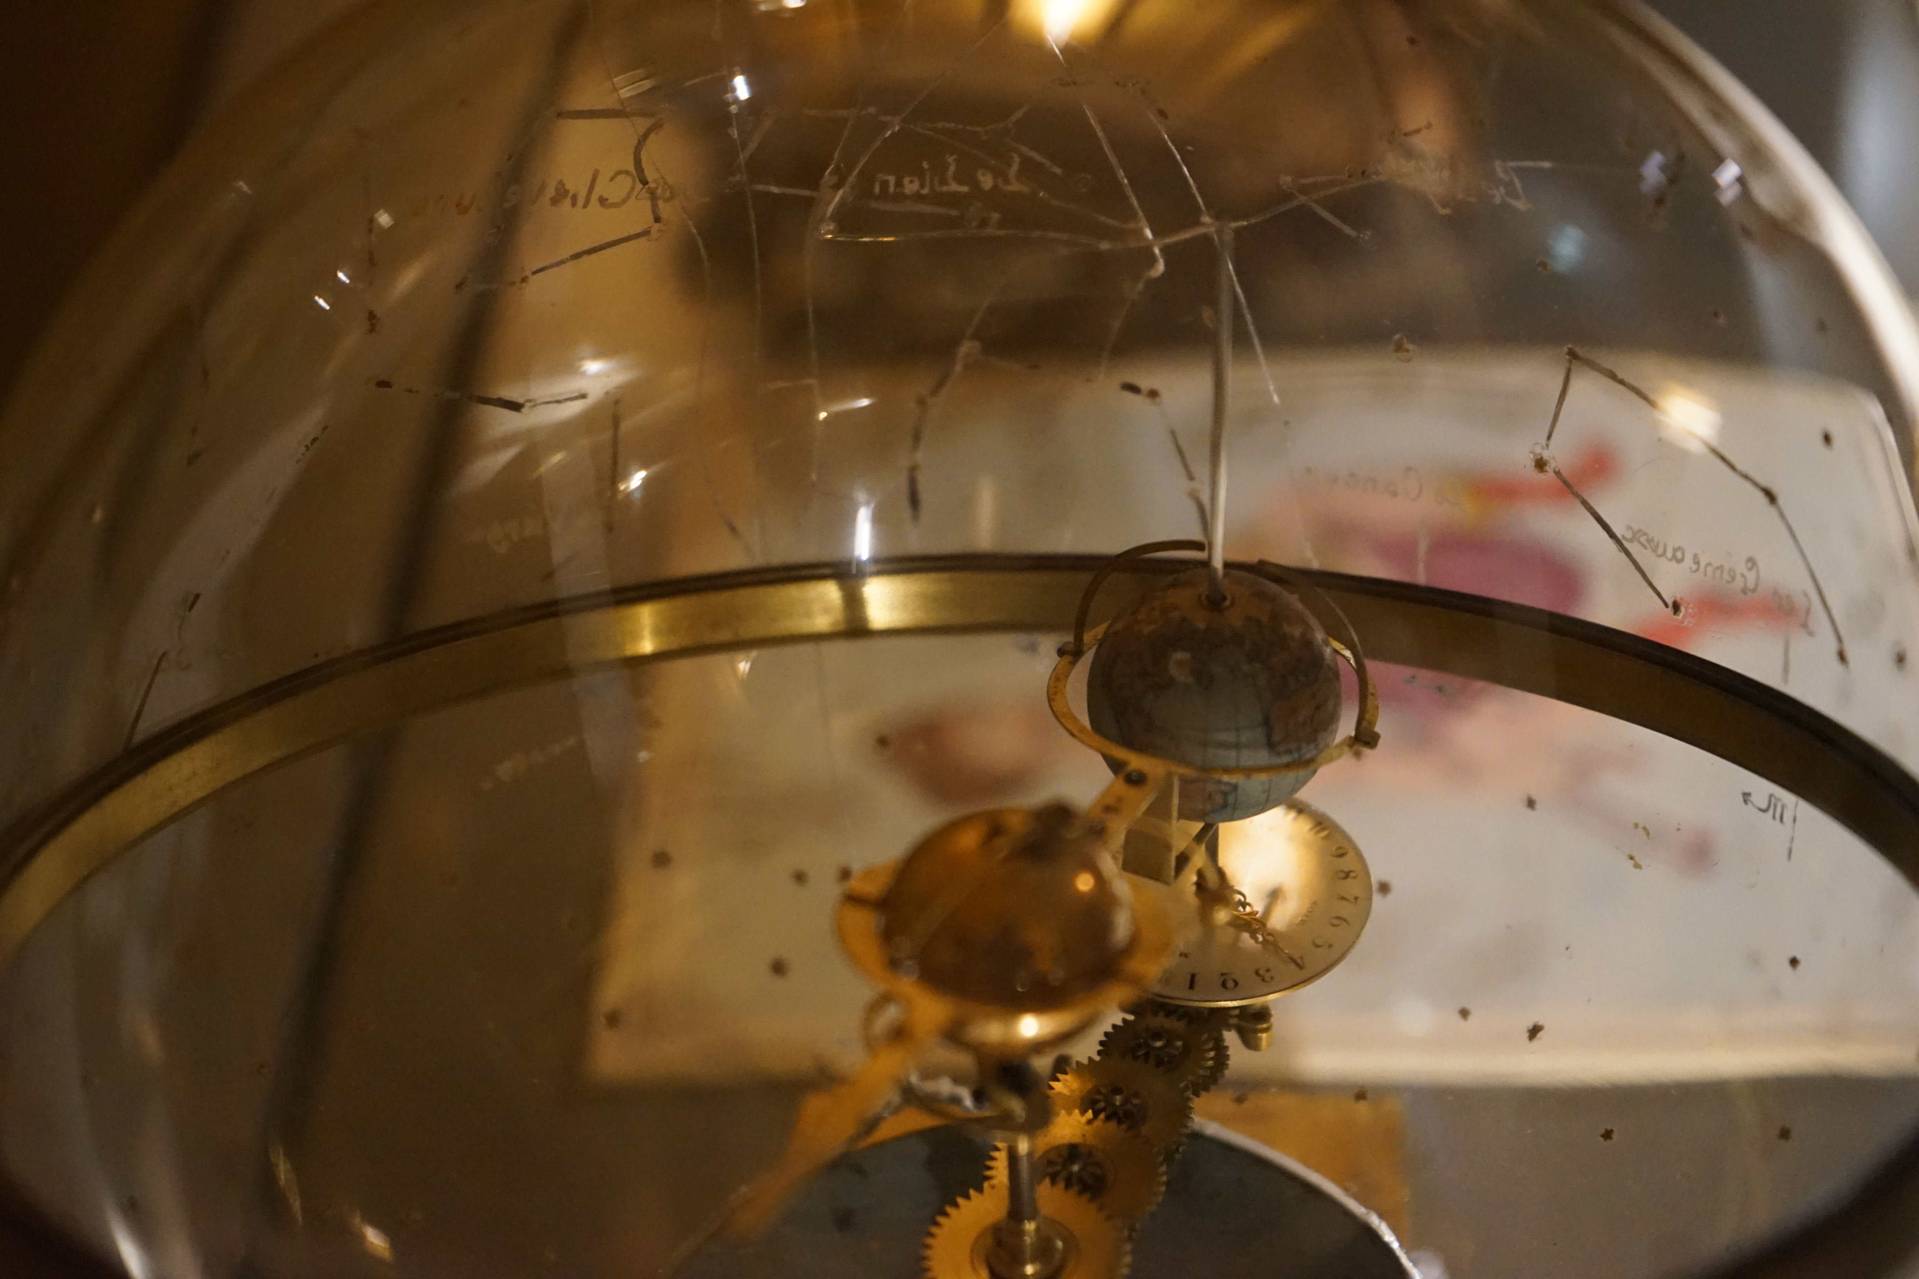
Yvonne Ban
12 Jan 2020
Royal Observatory Greenwich
London, UK

Slide 4

Part 1: Building a constellation
When we look at the sky, it seems like everything is projected on a ‘celestial sphere’.
In fact, stars and objects in the sky are located at vastly different distances from us, and each other.
The patterns we draw between them, such as constellations, might not reflect their real relations at all!
We’re going to get a better sense of the 3-D distribution of stars the sky.
Question to ponder: Are the more distant stars that make up a constellation’s figure more likely to be dimmer or brighter?

Slide 5
Part 1: Building a constellation
Open Stellarium. Zoom out so you have a good view. Press C to turn on constellation lines.
Let every person at the table pick a bright star in the constellation. Mark the constellation and stars on the whiteboard.
Try to pick stars that help you map out the shape of the constellation.
Each person finds the name, spectral type, and parallax of their respective star from Stellarium, and writes those next to the respective star and on the table worksheet.

Slide 6
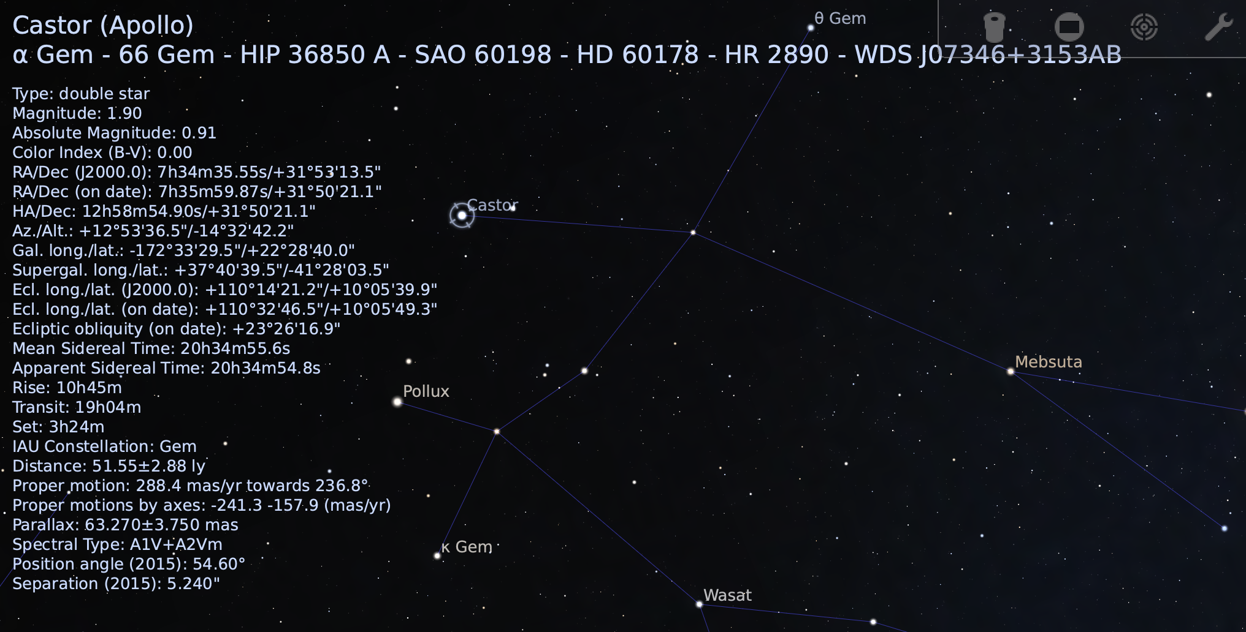
Part 1: Building a constellation
Open Stellarium. Zoom out so you have a good view. Press C to turn on constellation lines.
Let every person at the table pick a bright star in the constellation. Mark the constellation and stars on the whiteboard.
Try to pick stars that help you map out the shape of the constellation.
Each person finds the name, spectral type, and parallax of their respective star from Stellarium, and writes those next to the respective star and on the table worksheet.
Name: Castor
Spectral Type: A1
Luminosity Class: V
Parallax: 63.270 mas = 0.06327 arcsec

Slide 7
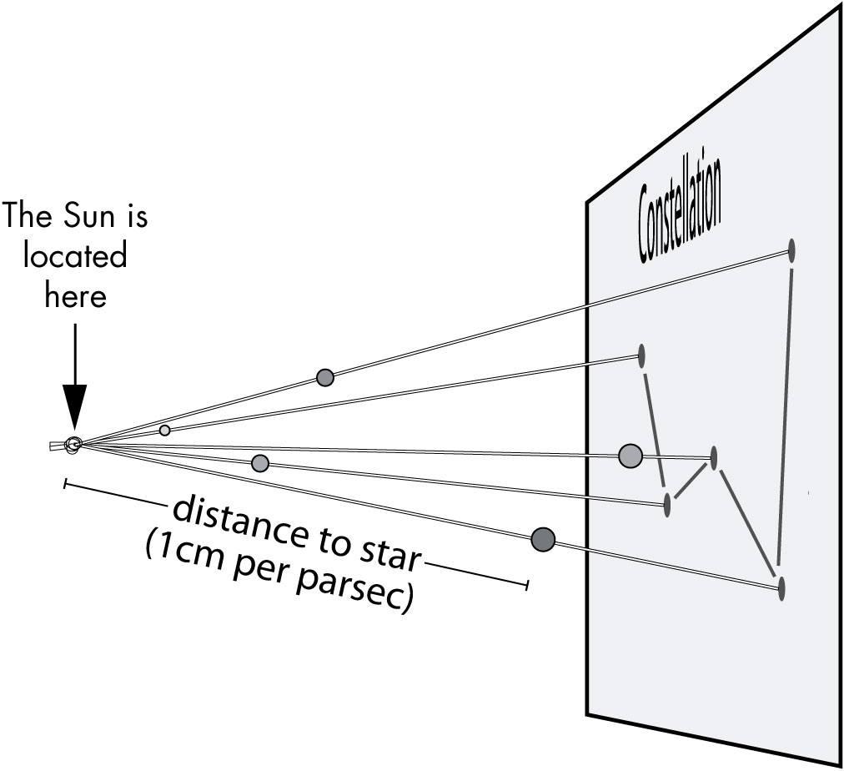
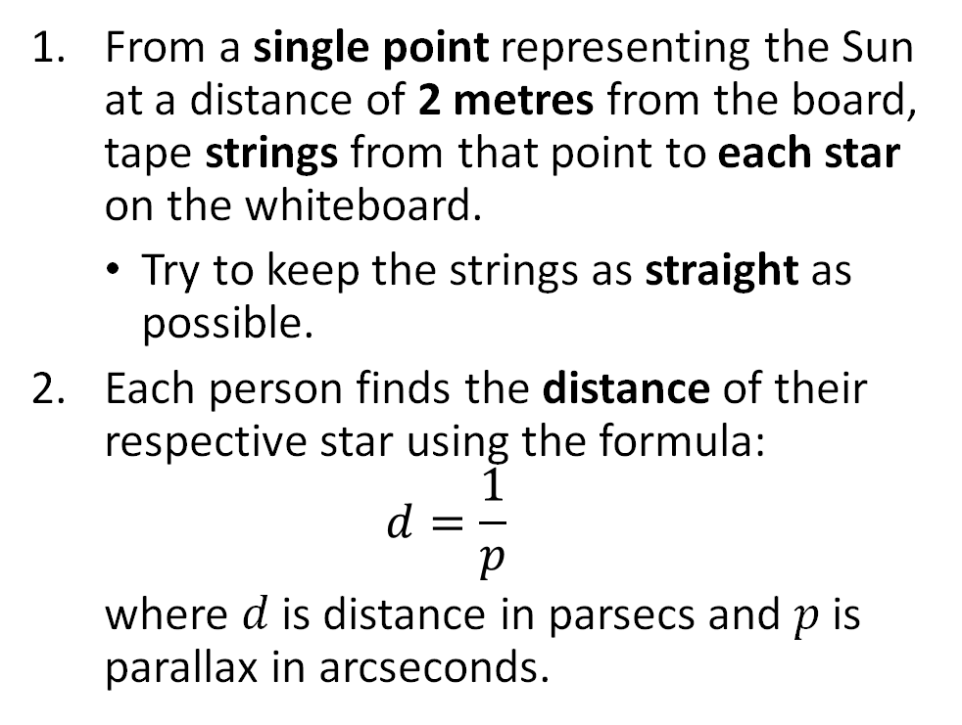
Part 1: Building a constellation (in 3D!)
From a single point representing the Sun at a distance of 2 metres from the board, tape strings from that point to each star on the whiteboard.
Try to keep the strings as straight as possible.
Each person finds the distance of their respective star using the formula:
$$d=\frac{1}{p}$$
where $d$ is distance in parsecs and $p$ is parallax in arcseconds.
Note: if parallax listed in milliarcseconds (mas) divide by 1000 e.g. 48 mas = 0.048 arcseconds

Slide 8
Part 1: Building a constellation (in 3D!)
Each person selects a coloured ball to represent their respective star where
the colour is determined by its type: O or B: violet, A: blue, F: green, G: yellow, K: orange, M: red
the size is determined by its luminosity class: I: LARGE, II or III: Medium, IV or V: small
Write this information on the table worksheet.
Fasten each star on the constellation strings at their respective distance from the Sun, with 1 cm representing 1 parsec.

Slide 9
Part 2: A change of scene
Move 10-20 parsecs (10-20 cm) to either side of the Sun and sketch the pattern of stars from the new position.
Discuss at your table: Which star appears to move the most? Why?
Copy one of your pair of sketches to the table worksheet.
Go around the room and look at other tables’ constellations.
Neptune is 4.475 billion km / 2.793 billion miles / 0.00014502 parsecs from the Sun. Would the constellations look very different from there?

Slide 10
It’s all about perspective
Complete the end-of-lab 6 quiz before leaving, and make sure you put your name on your table worksheet before it is turned in.

Slide 11
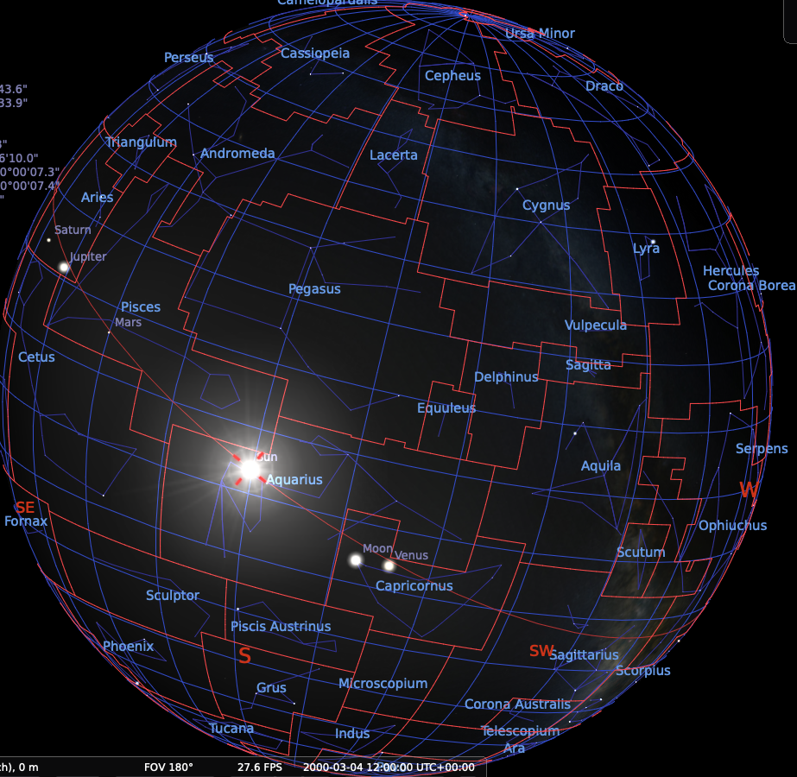
Quiz password: cuttlefish
Remember to write your name on the table worksheet and turn it in!

